Slide 1
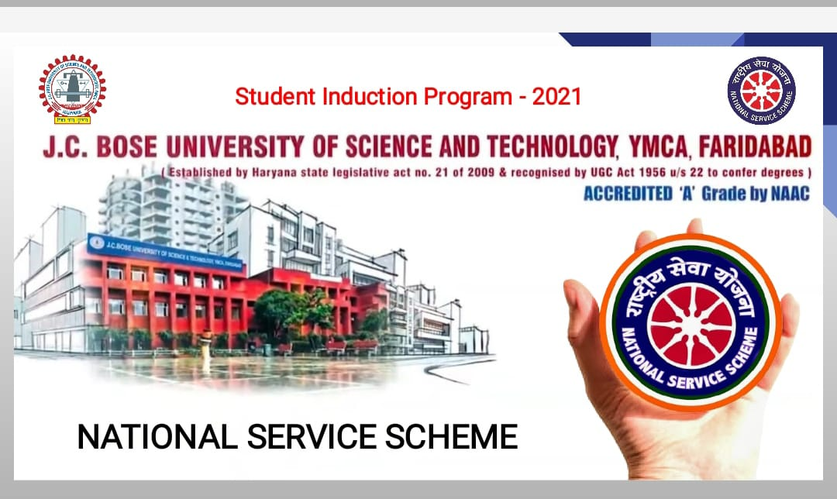

Slide 2
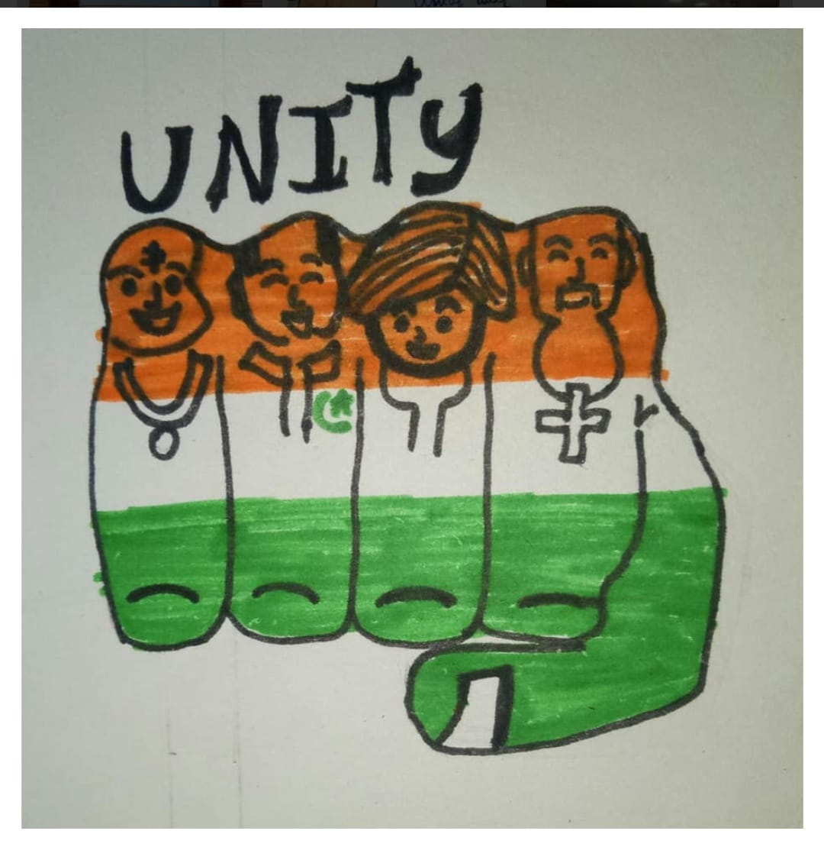

Slide 3
About NAtional service scheme
A Central Scheme of Government of India, Ministry of youth
Affair & Sports.
Launched in Gandhi ji’s Centenary Year on 24th September 1969.
Initially 40,000 Members.
Now more than 4 million.

Slide 4


Slide 5
Aim of NSS
To make education more relevant.
To develop qualities of Leadership.
To emphasize dignity of labour and self help.
To encourage the youth participate in Social work

Slide 6


Slide 7
Objectives Of NSS
To understand the community.
To identify the needs and the problems.
To involve them in problem solving process.
To acquire leadership quality and democratic attitude

Slide 8
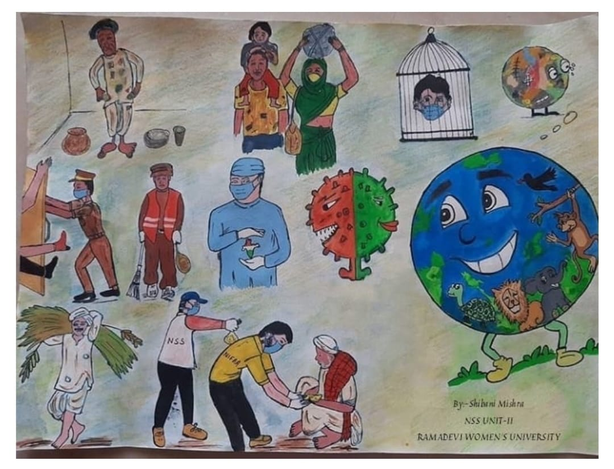

Slide 9
Why to join NSS ?
An accomplished social leadership
An efficient administrator
A person who understands human nature

Slide 10
Who was First Volunteer ?
KK Gupta university of Delhi was declared first Volunteer.

Slide 11
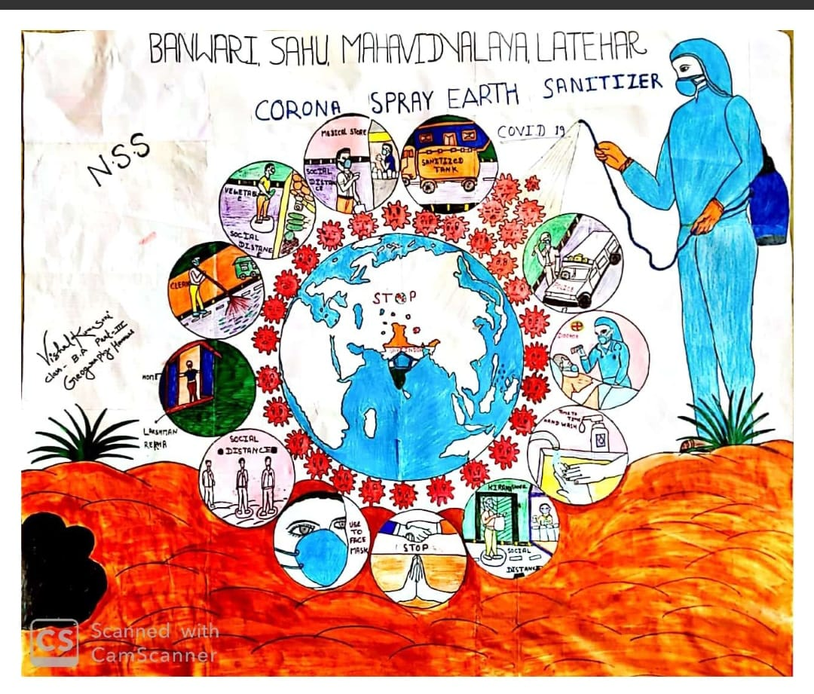

Slide 12
Thank you
PPT by - Tabish (ME) !

